Slide 1
Capstone Project-4
Online Retail Customer Segmentation Submitted by:- Rinkesh Das Data Science Trainee, Almabetter Cohort Kaimur

Slide 2
Outline
Problem Statement
Data Description
Data Cleaning
Exploratory Data Analysis (EDA)
Data Preprocessing
Model Training and Implementation
Visualization of the clusters formed in various models
Model Evaluation
Model Valdidation
Challenges Faced

Slide 3
Customer Segmentation
Customer segmentation is the practice of dividing a customer base into groups of individuals that are similar in specific ways relevant to marketing, such as age, gender, interests and spending habits.
Companies employing customer segmentation operate under the fact that every customer is different and that their marketing efforts would be better served if they target specific, smaller groups with messages that those consumers would find relevant and lead them to buy something.
Customer segmentation relies on identifying key differentiators that divide customers into groups that can be targeted. Information such as a customers’ demographics (age, race, religion, gender etc.), geography (where they live and work), psychographic (social class, lifestyle and personality) and behavioral (spending, consumption etc.) tendencies are taken into account when determining customer segmentation practices.

Slide 4

Customer Segmentation
Customer segmentation can have a great effect on customer management by dividing customers into different groups that share similar needs, the company can market to each group differently and focus on what each kind of customer needs at any given moment. Large or small, niche customer segments can be targeted depending on the company's resources or needs.
Customer segmentation can also improve customer service and assist in customer loyalty and retention.

Slide 5
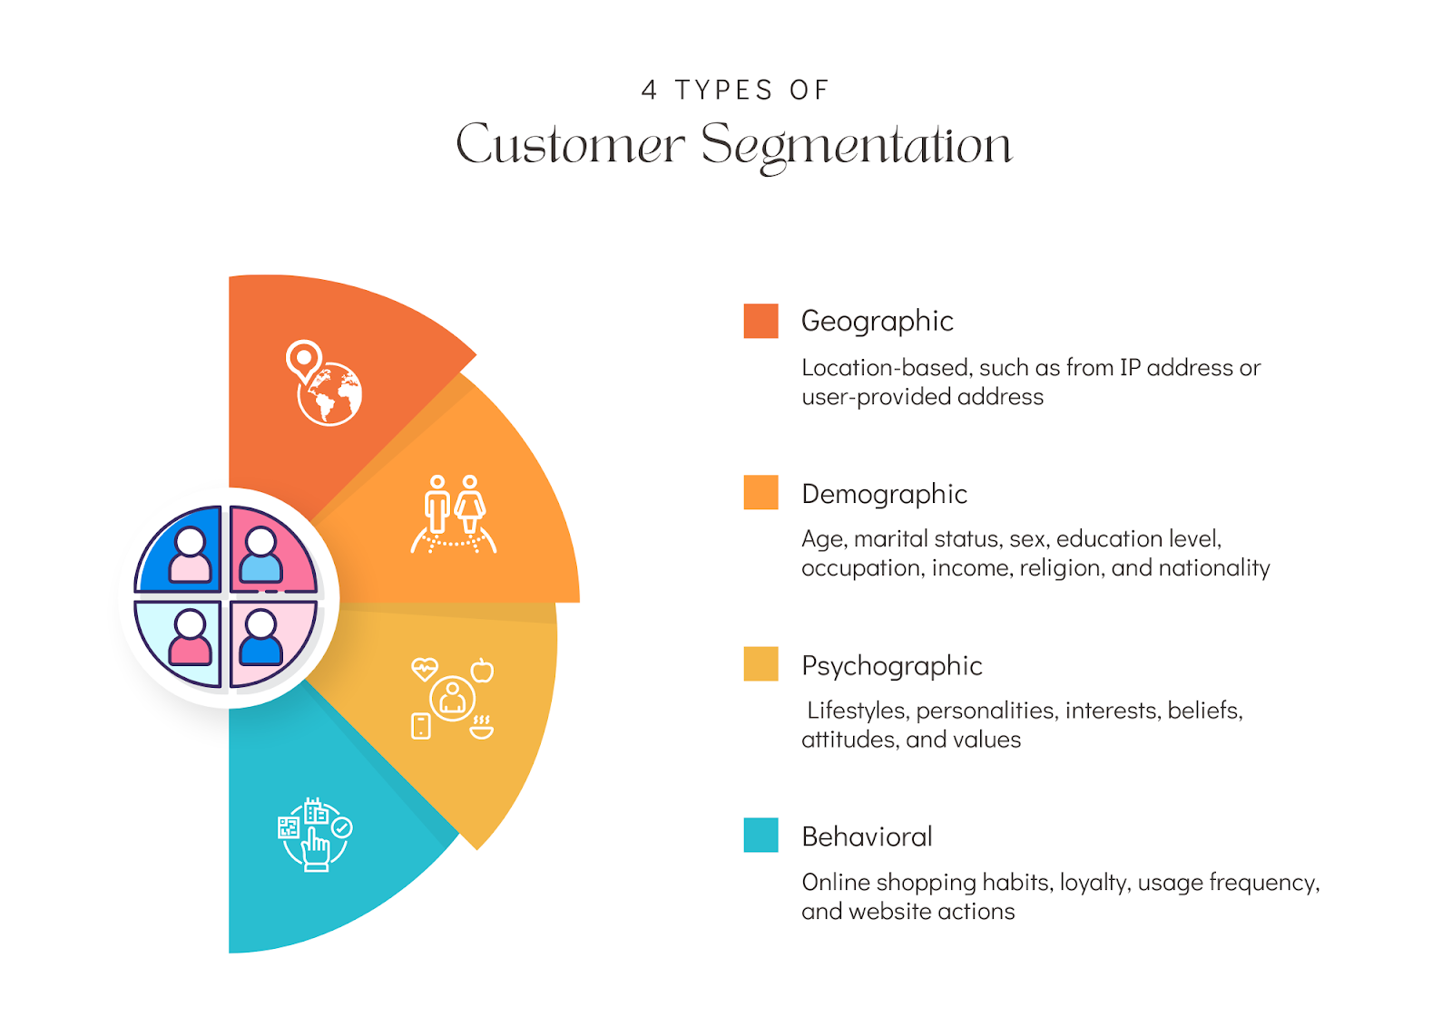
Customer Segmentation
From the data available, behavioural segmentation is the most suitable.

Slide 6

Problem Statement
Identify major customer segments on a transnational data set which contains all the transactions occurring between 01/12/2010 and 09/12/2011 for a UK-based and registered non-store online retail.
According to the data available the company mainly sells unique all-occasion gifts. Many customers of the company are wholesalers.

Slide 7
Data Cleaning
Data Analysis
Model Training
Observing the dataset.
Getting information about the columns and their data types.
Checking and removing the null and duplicated values from the dataset.
Examining the patterns of distribution and relations between variables through various plots.
Getting inference from those plots and processing the data accordingly.
Training machine learning models on the dataset.
Testing the performance of the models on the dataset.
Validating the models with the use of metrics.

Slide 8
Data Description
Attribute Information:
Invoice No: Invoice number. Nominal, a 6-digit integral number uniquely assigned to each transaction. If this code starts with letter 'c', it indicates a cancellation.
Stock Code: Product (item) code. Nominal, a 5-digit integral number uniquely assigned to each distinct product.
Description: Product (item) name. Nominal.
Quantity: The quantities of each product (item) per transaction. Numeric.
Invoice Date: Invoice Date and time. Numeric, the day and time when each transaction was generated.
Unit Price: Unit price. Numeric, Product price per unit in sterling.
Customer ID: Customer number. Nominal, a 5-digit integral number uniquely assigned to each customer.
Country: Country name. Nominal, the name of the country where each customer resides.

Slide 9
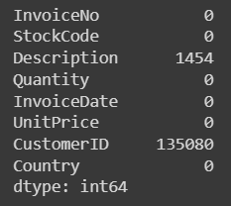
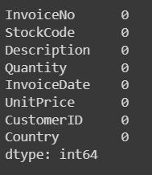
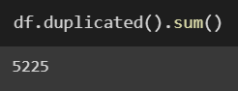
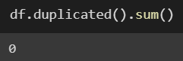
Data Cleaning
The dataset contains 541909 rows and 8 columns.
It contains 3 numerical,4 categorical and 1 datetime variable.
Before
After

Slide 10
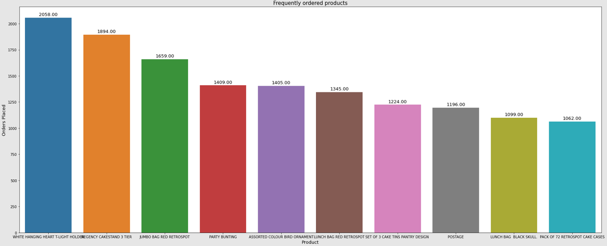
Exploratory Data Analysis (EDA)
It is observed that White Hanging Heart T-Light Holder is the most frequently ordered product.

Slide 11
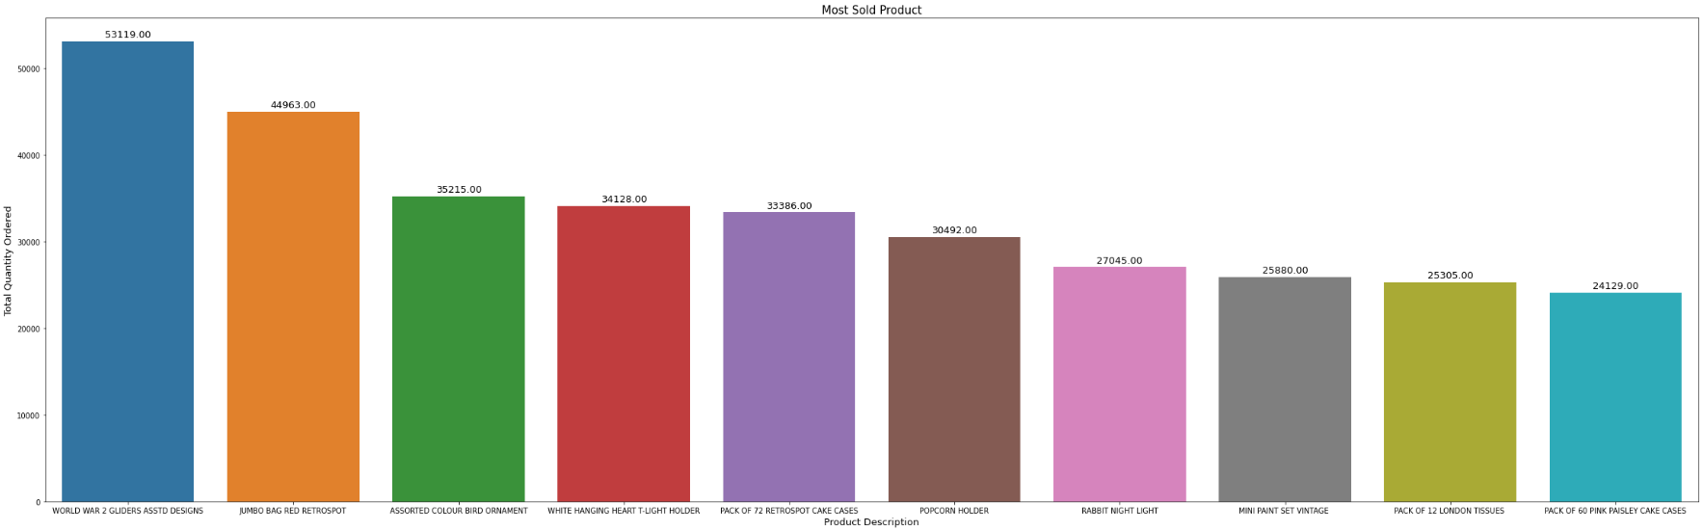
Exploratory Data Analysis (EDA)
It is observed that World War 2 Gliders asst designs is the product sold in the highest quantity.

Slide 12
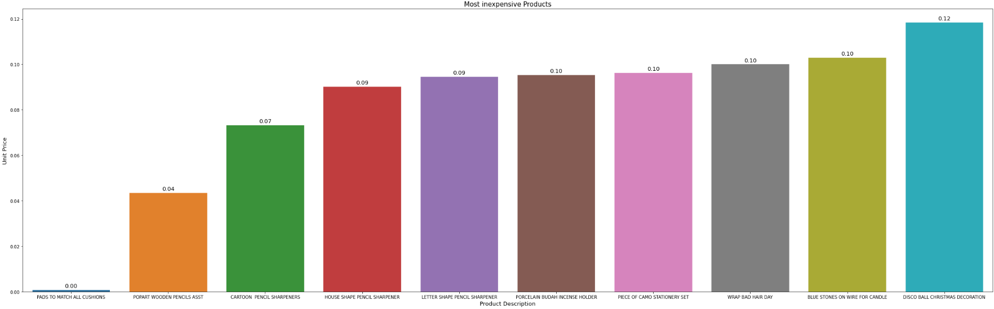
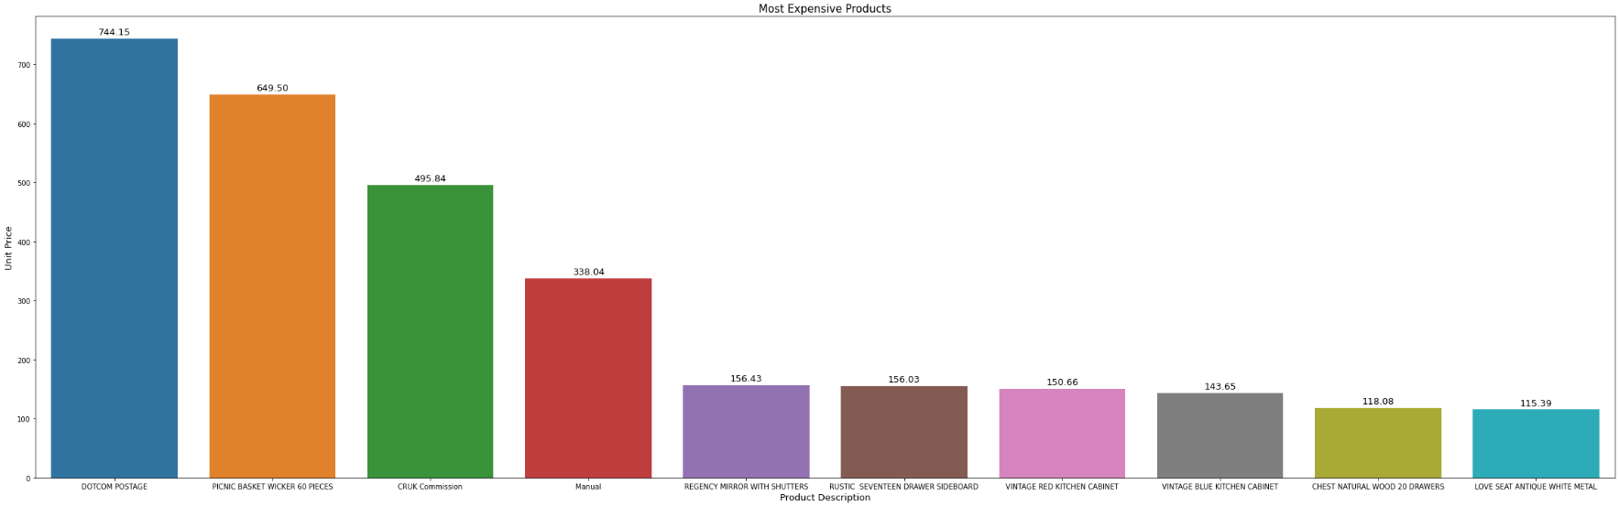
Exploratory Data Analysis (EDA)
It is observed that Dotcom Postage is the most expensive product.
Pads to match all cushions and pop art wooden pencils asst are the most inexpensive product.

Slide 13
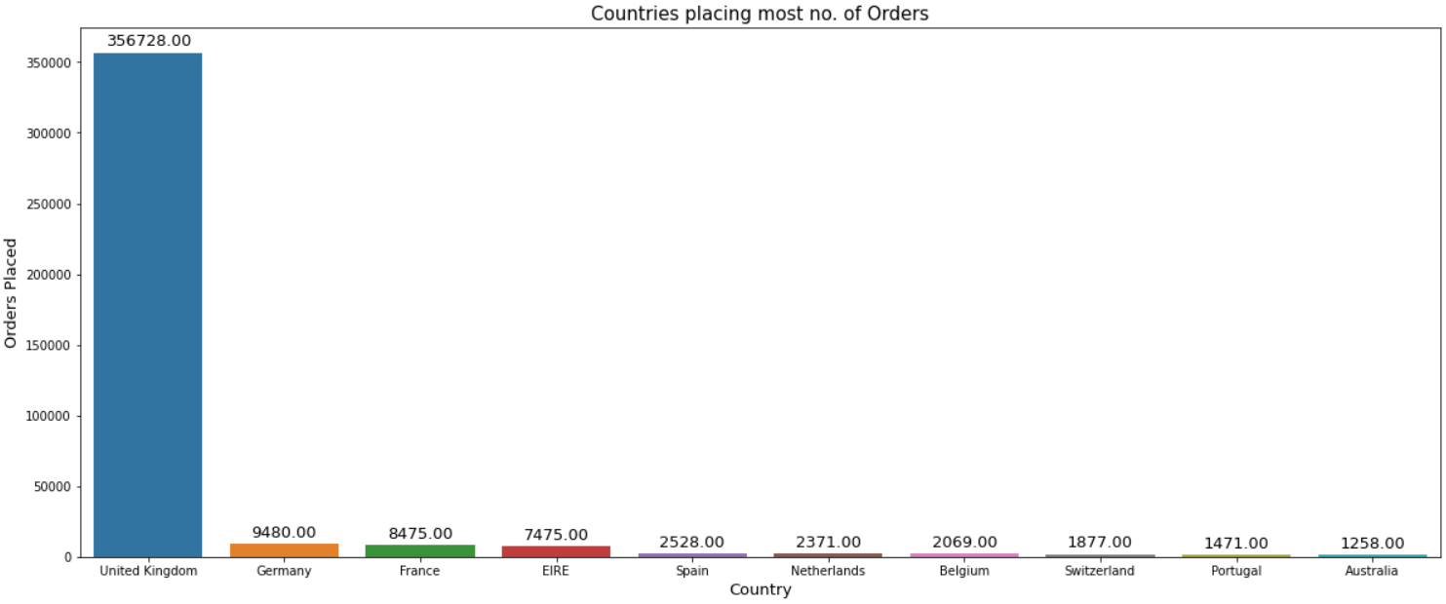
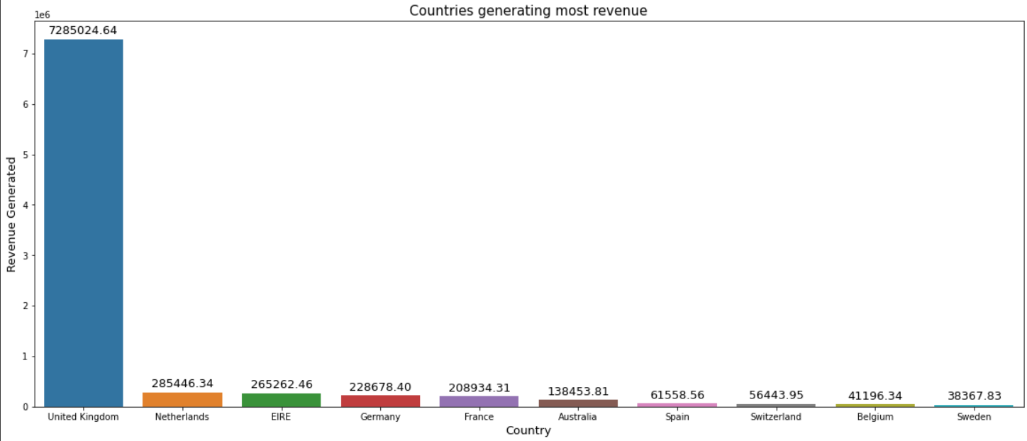
Exploratory Data Analysis (EDA)
It is observed that most of the customers are from the United Kingdom.
Also, United Kingdom generates the highest revenue followed by Netherlands.

Slide 14
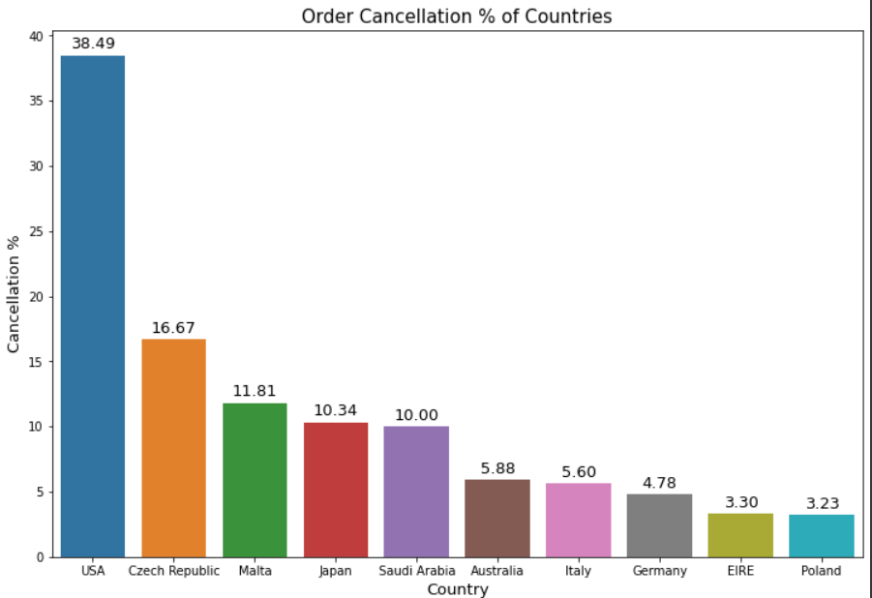
Exploratory Data Analysis (EDA)
It is observed that USA has the highest order cancellation % followed by Czech Republic.

Slide 15
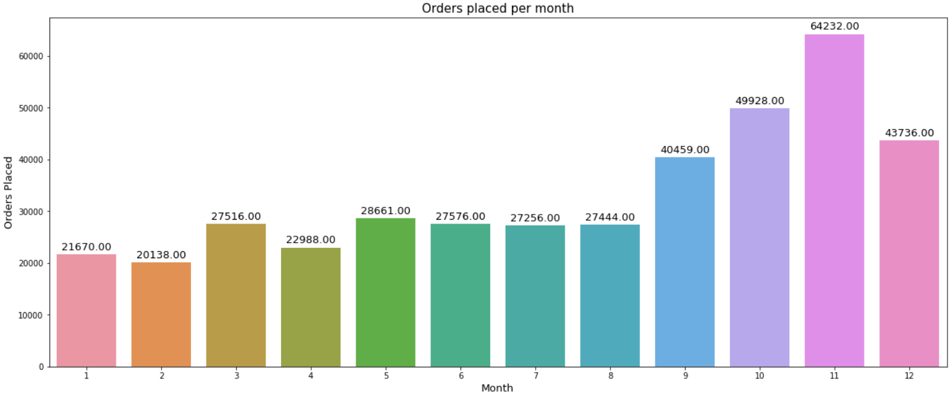
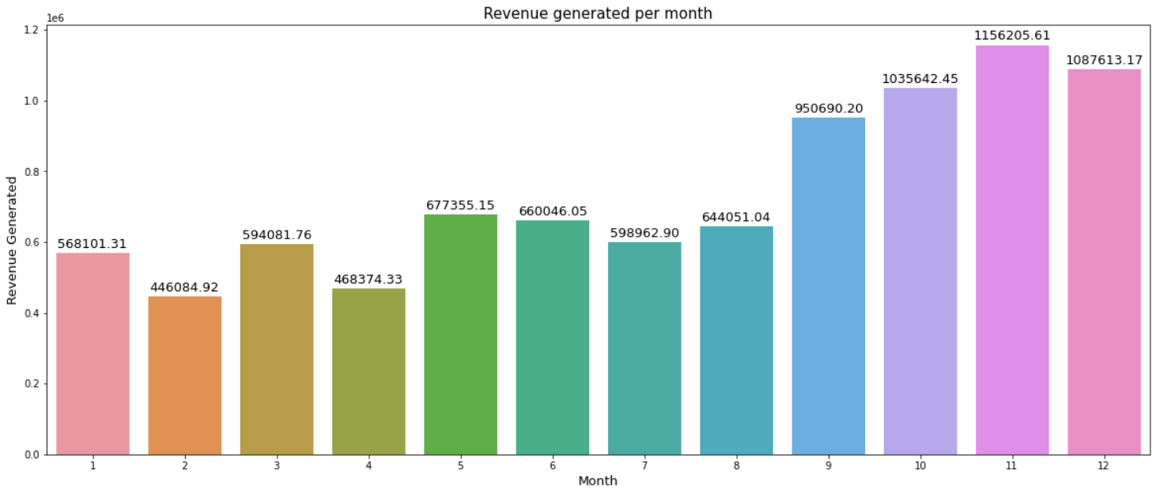
Exploratory Data Analysis (EDA)
It is observed that November receives the highest number of orders and generates the highest revenue.

Slide 16
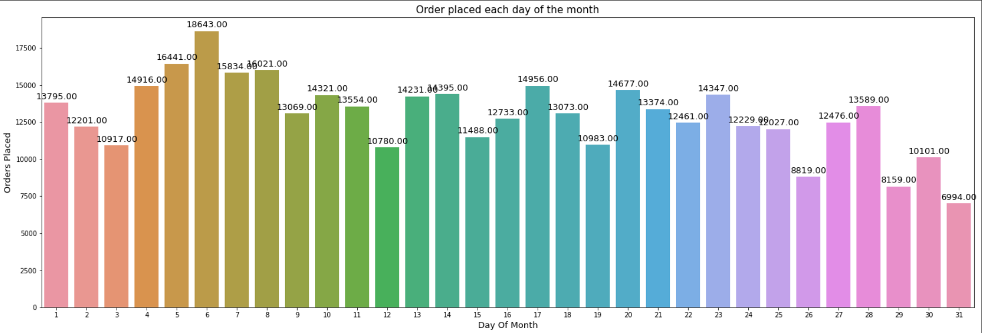
Exploratory Data Analysis (EDA)
It is observed that the first 8 days of the month receive the highest number of orders as compared to other days.

Slide 17
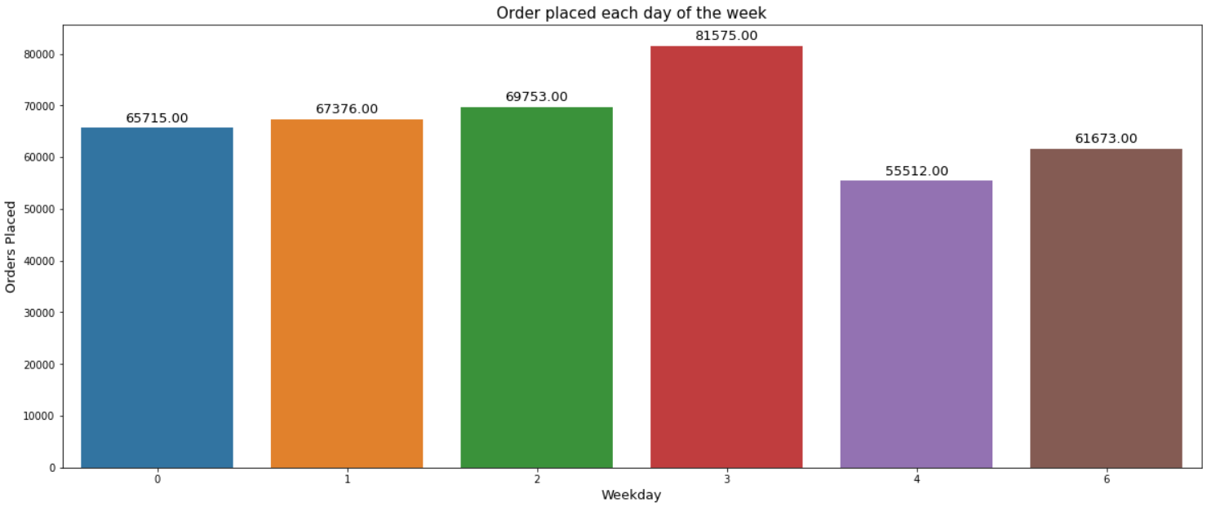
Exploratory Data Analysis (EDA)
It is observed that Thursday receives the highest number of orders as compared to other days of the week.

Slide 18
Conclusions from EDA
World War 2 Gliders Asstd Design is the product ordered in higher quantity.
Dotcom Postage is the most expensive product.
Pads to match all cushions and pop art wooden pencils asst are the most inexpensive product.
White Hanging Heart T-Light Holder is the most frequently ordered product.
The UK generates the highest revenue followed by the Netherlands.
Most of the customers belong to the UK.
USA has the highest order cancellation %.
The highest revenue is generated in November.
The highest number of orders are placed in November.
Thursday receives the highest number of orders.
The 6th day of the month receives the highest number of orders. The number of orders in the 1st 8 days of the month is comparatively higher than the rest of the days.

Slide 19
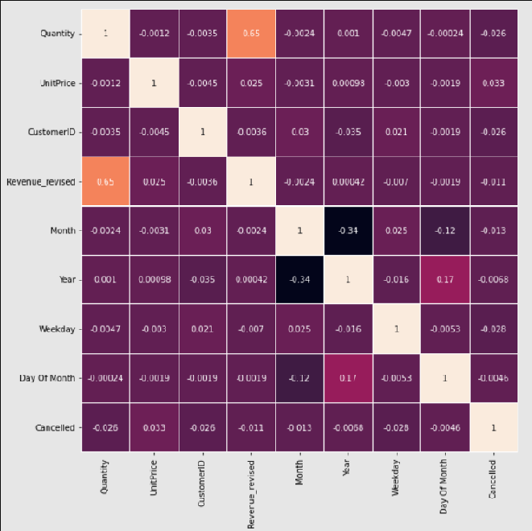
Correlation among variables
Almost all the variables have low correlation with each other.
There are a few variables that are moderately correlated.
None of the variables are highly correlated with each other.

Slide 20
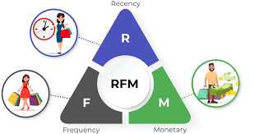
RFM Analysis
RFM analysis refers to the method of customer segmentation on the basis of :-
Recency- How recent was the last purchase made by the customer?
Frequency- How frequently does the customer make a purchase?
Monetary- What is the customers contribution in the revenue of the company/store.

Slide 21
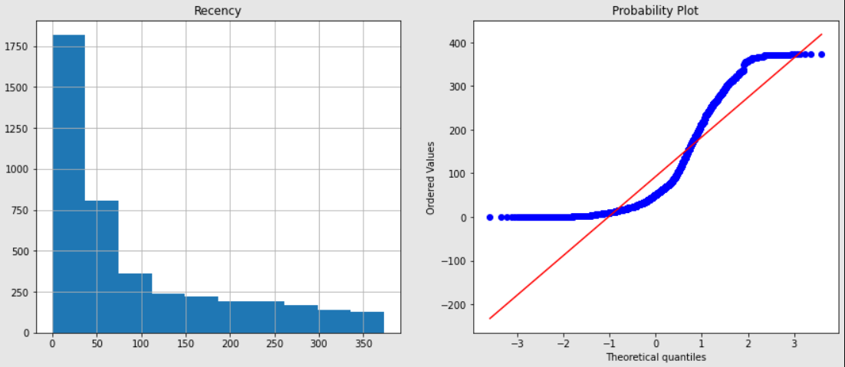
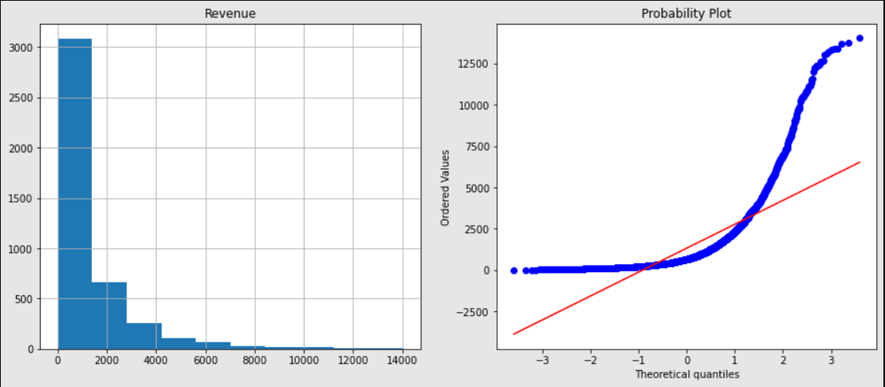
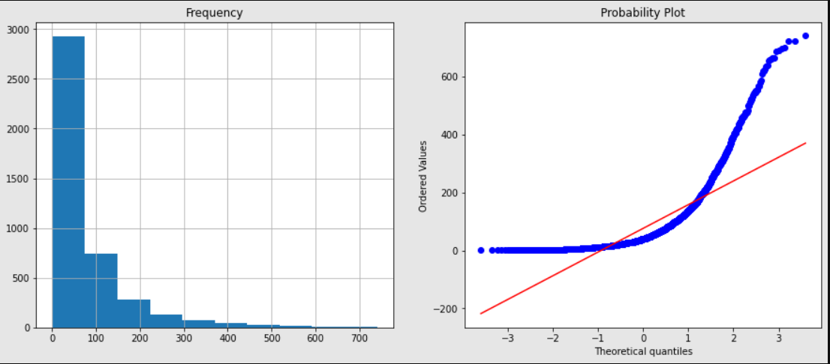
Data Preprocessing
DISTRIBUTION OF VARIABLES BEFORE SCALING

Slide 22
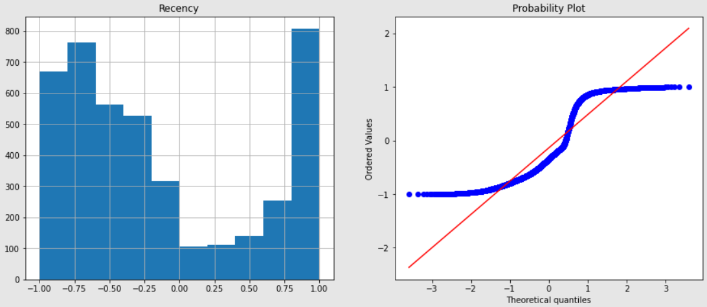
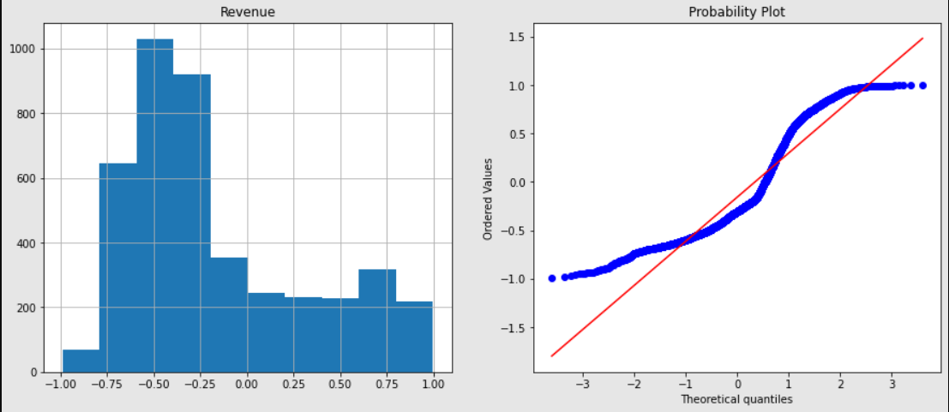
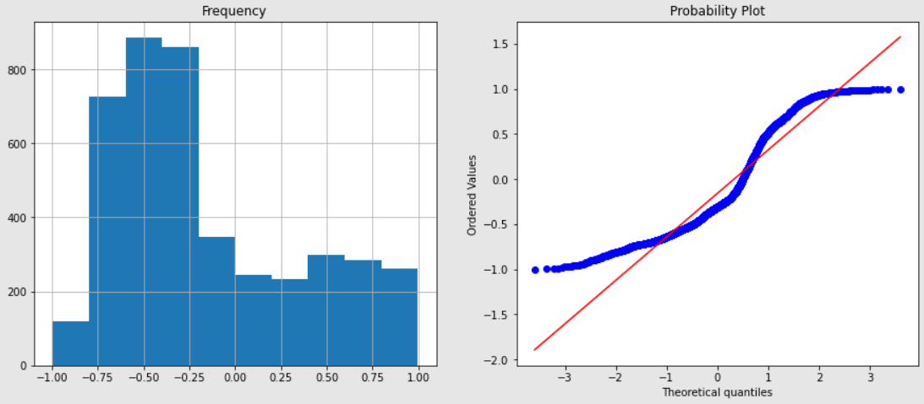
Data Preprocessing
DISTRIBUTION OF VARIABLES AFTER SCALING

Slide 23
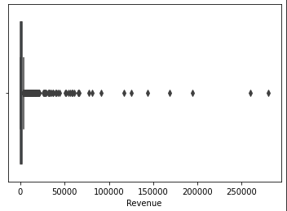
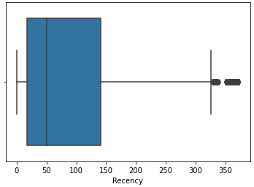
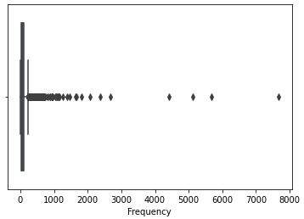
Data Preprocessing
OUTLIERS IN THE VARIABLES BEFORE SCALING

Slide 24
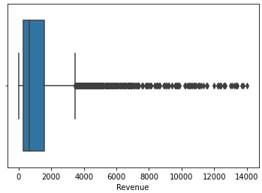
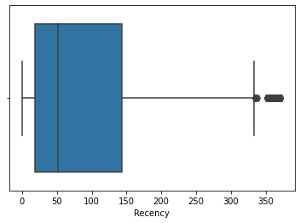
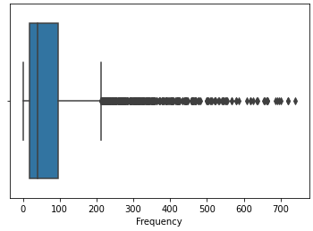
Data Preprocessing
OUTLIERS IN THE VARIABLES AFTER SCALING

Slide 25
Model Training and Implementation
Models used for training
Kmeans Clustering
Agglomerative Clustering
DBSCAN
Spectral Clustering
Metrics used for evaluation
Davies Bouldin Score
Calinski Harabasz Score
Silhouette Score

Slide 26
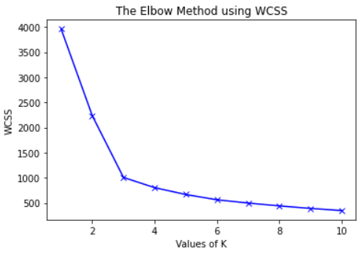
KMeans Clustering
From the elbow method as well as the silhouette method we conclude that the optimal number of clusters for our KMeans model is 3.

Slide 27
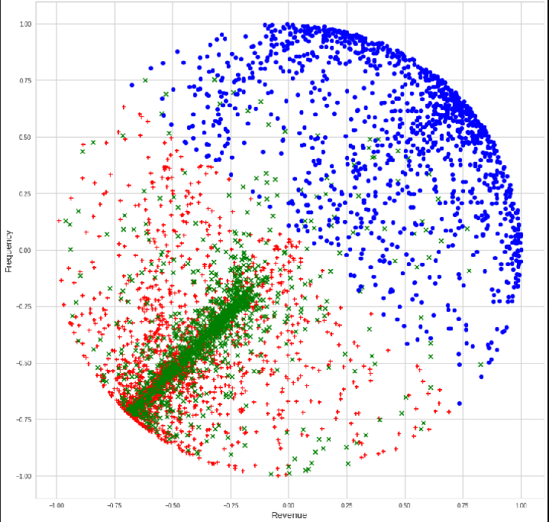
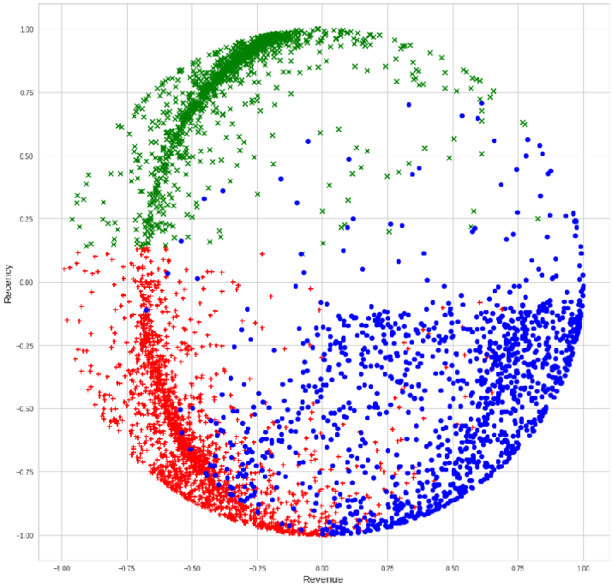
KMeans Clustering

Slide 28
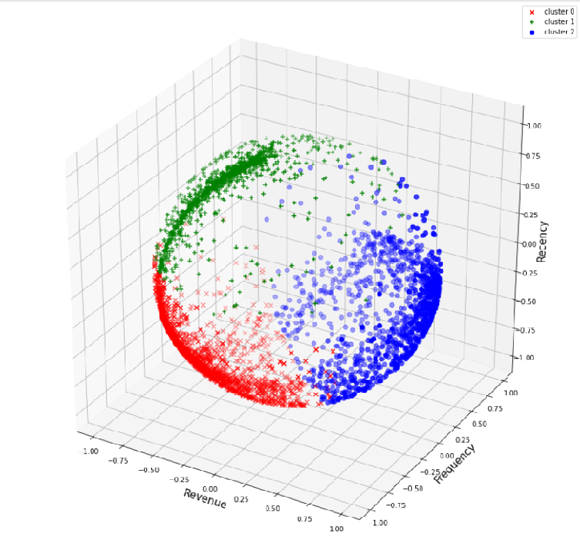
KMeans Clustering

Slide 29
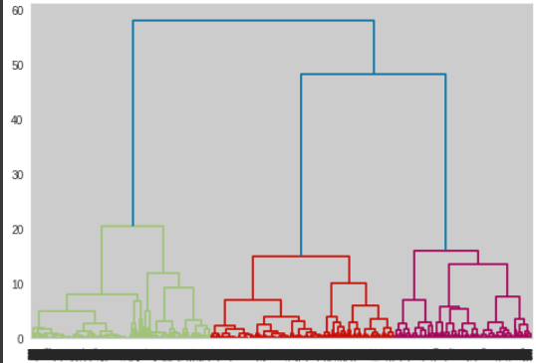
Agglomerative Clustering
From the dendrogram formed by using Hierarchical clustering, we conclude that the optimal number of clusters for our Agglomerative clustering model is 3.

Slide 30
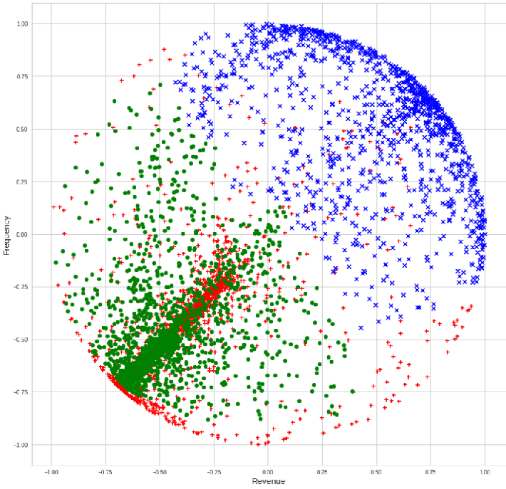
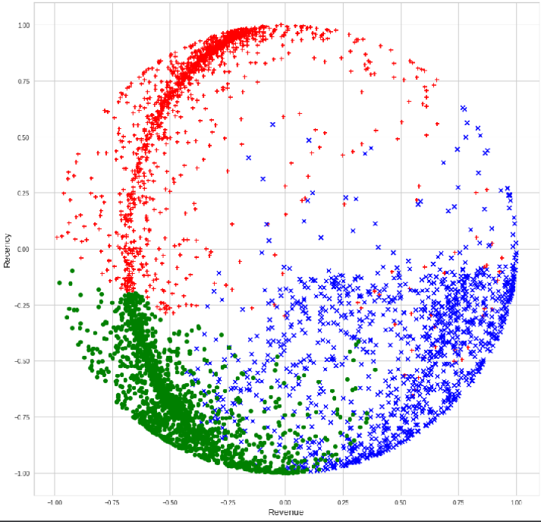
Agglomerative Clustering

Slide 31
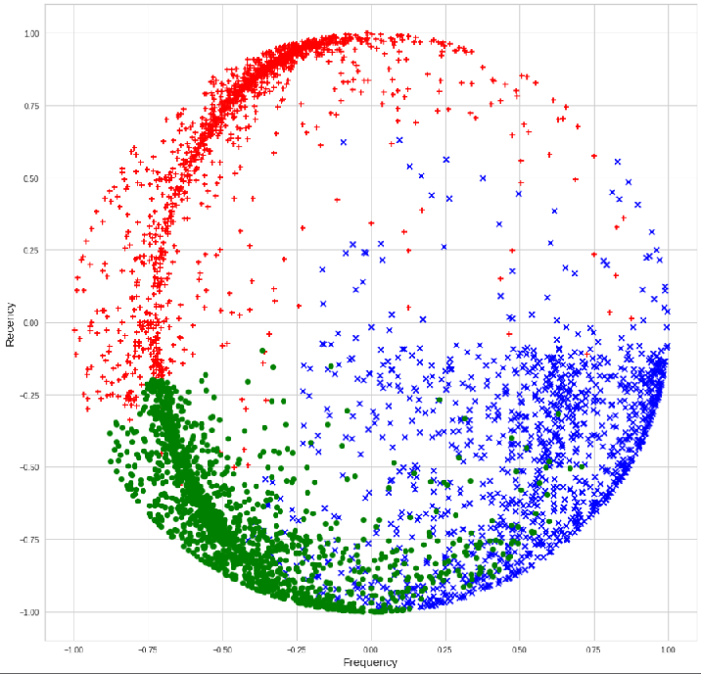
Agglomerative Clustering

Slide 32
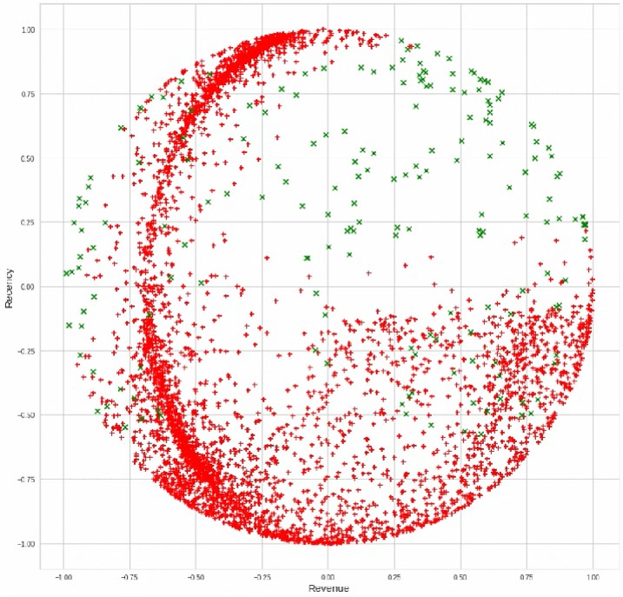
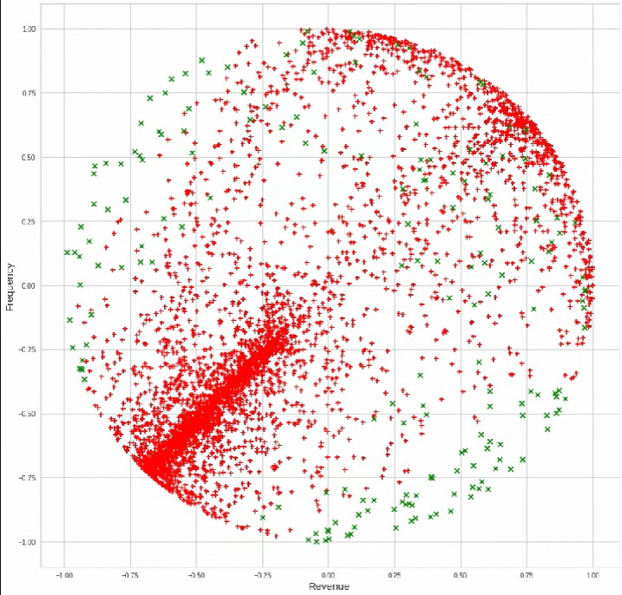
DBSCAN

Slide 33
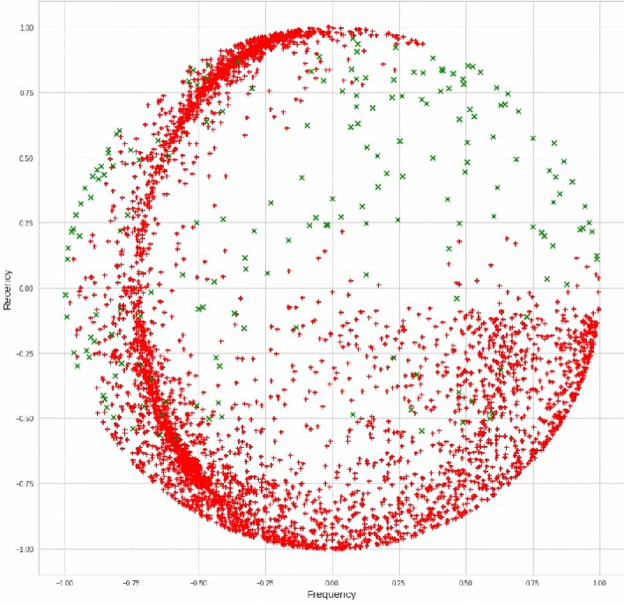
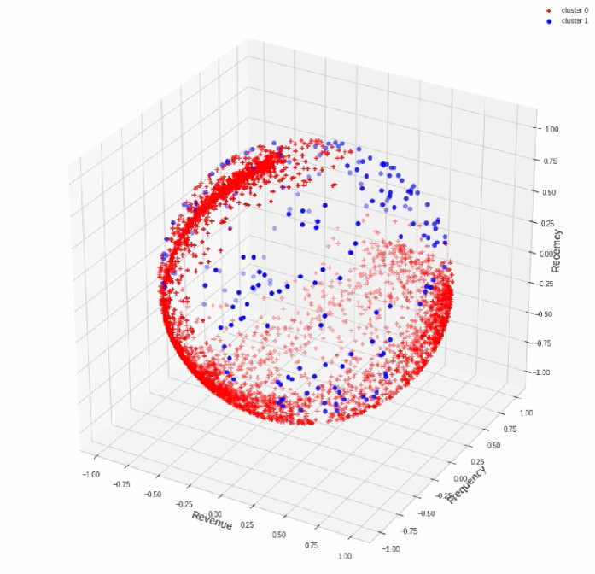
DBSCAN

Slide 34

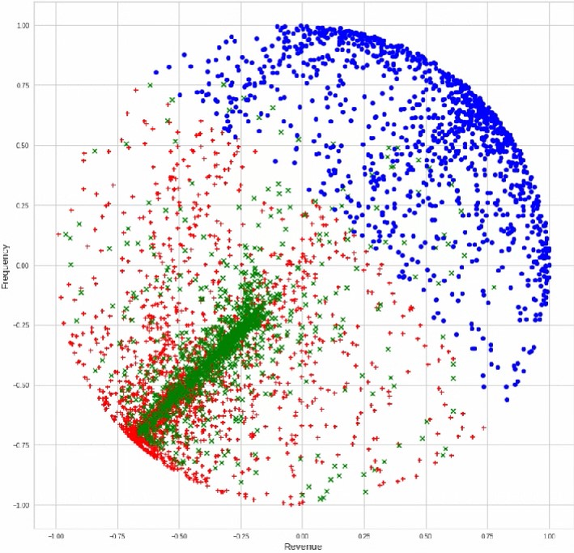
Spectral Clustering

Slide 35
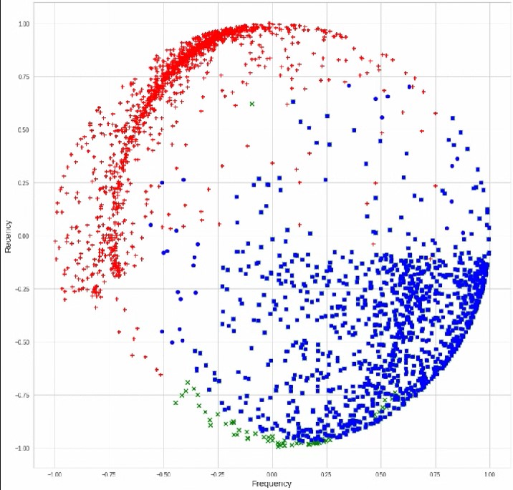
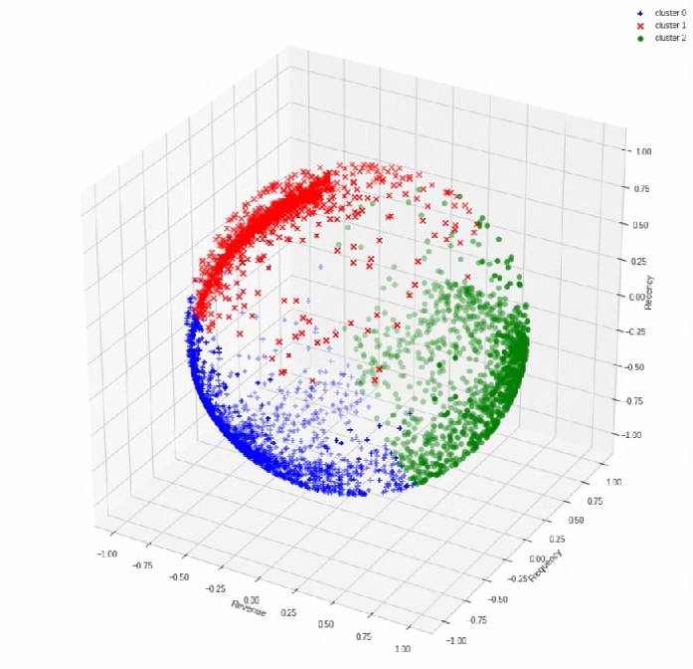
Spectral Clustering

Slide 36
Model Evaluation
Model | Davies Bouldin Score | Calinski Harabasz Score | Silhouette Score
Kmeans Clustering | 0.647771 | 6257.644861 | 0.561082
Agglomerative Clustering | 0.661018 | 5427.080599 | 0.525049
DBSCAN | 3.475507 | 56.903785 | 0.118979
Spectral Clustering | 0.653888 | 6068.817416 | 0.556409

Slide 37
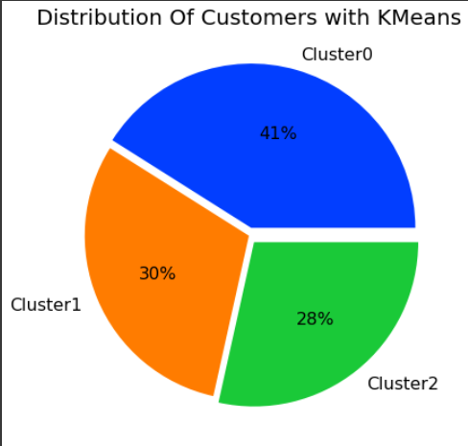
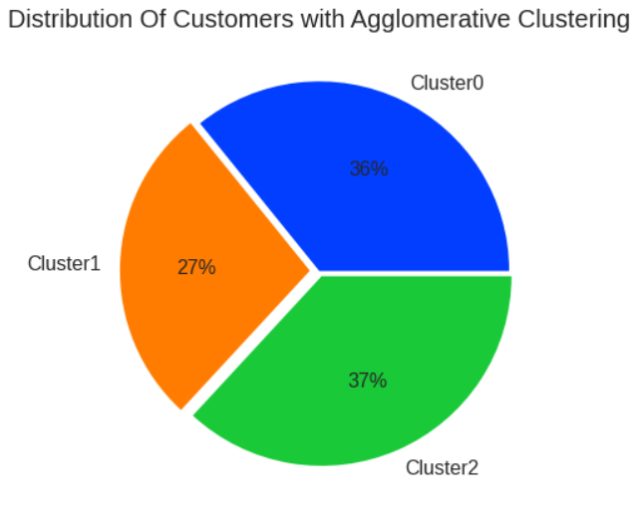
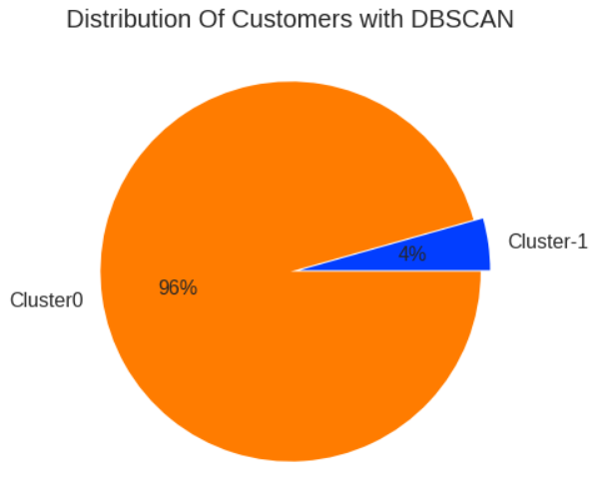
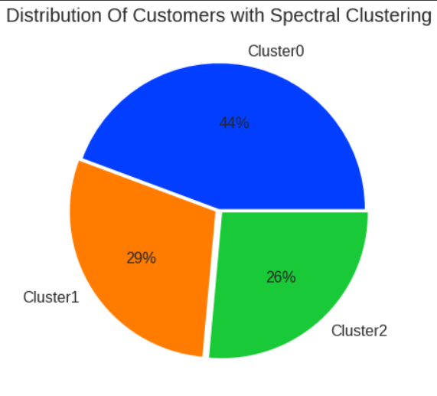
Customer Distribution in the models

Slide 38
Model Validation
From the evaluation metrics, KMeans Clustering has the lowest Davies Bouldin Score and highest Calinski Harabasz Score and Silhouette Score.
It is observed that in KMeans Clustering, Cluster 0 contains 41% of the customers , Cluster 1 contains 29% of the customers and the Cluster 2 contains 30% of the customers. So the distribution is quite acceptable.
So, we choose KMeans Clustering as the optimal model for our problem

Slide 39
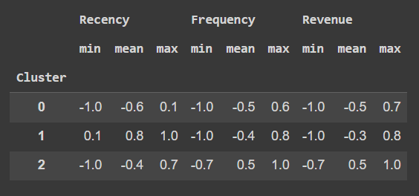

Conclusions from the model
Cluster 0 contains the customers who have not made a recent purchase. They are not frequent buyers and also do not contribute much to the revenue as well.
Cluster 1 contains the customers who have made a recent purchase. They are not frequent buyers and do not have a considerable contribution in the revenue.
Cluster 2 contains the customers who have not made a recent purchase. They are frequent buyers and contribute majorly to the revenue.
So, the company should focus more on the customers in Cluster 2 as they are the most important segment.

Slide 40
Challenges Faced
Comprehending the problem statement and knowing the business implications.
Getting rid of all the null and duplicate values in the dataset.
Choosing on which visualisation to use in order to know the relationship between the variables in a better way.
Pre-processing the dataset in the suitable way.
Handling the outliers in the dataset.
Choosing the optimal number of clusters for the problem.
Choosing the evaluation metrics to evaluate the models.
Monitor the model performance and validate the optimum model for the problem.

Slide 41


